Slide 1
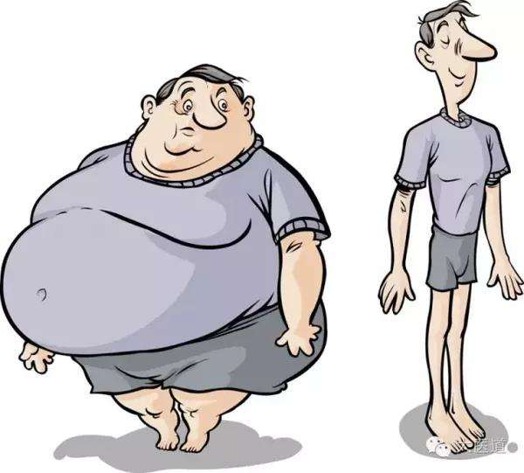
In ICU,
Who endure longer MV ?
Who better survive ?

Slide 2


The relationship between BMI and clinical outcomes in critically ill patients
ICU患者BMI指数和临床结局指标的关系
康红军，hongjun Kang
The Department of Critical Care Medicine, Chinese PLA General Hospital
The 2nd 301-MIT health data conference and Datathon 2017年11月3-5日（北京）

Slide 3


成员介绍
Team introduction
医学博士，主任医师，副教授，硕士研究生导师。解放军总医院重症医学科副主任。美国哈佛大学医学院博士后。
研究领域：脓毒症、多发性创伤、热射病、干细胞以及临床大数据分析。近年来，从事大数据分析等相关研究，在MIMIC数据库应用领域做了大量的工作。
Doctor of medicine, chief physician, associate professor, supervisor of postgraduate. Associate director of Critical Care Medicine of PLA General hospital. Postdoctoral Fellow of Harvard University. Research field including sepsis, multiple trauma, heatstroke, stem cells and big data analysis. In recent years, as a member of team do a lot of work on MIMIC database.
以第一作者或通讯作者发表论文30篇，其中SCI收录10篇。拥有发明专利1项，软件著作权3项，实用新型专利1项。主译著作1部，副主编4部。承担国家自然基金1项，军队及省部级课题6项。 2015年获得解放军医疗成果二等奖1项。
As the first or corresponding author published 30 papers , among which 10 were indexed by SCI. Got 1 invention patent, 4 software copyrights. Published 5 works as chief translator or associate chief editor. Took over 7 projects including 1 National Natural Science Foundation. In 2015, won the second prize of military medical achievements award.
Captain: 康红军
hongjun Kang

Slide 4


Technical
Advising team
Philips
Clinical
Counselor
沈鹭，Lu Shen
刘星刚, XG Liu
BIDMC
Database engineer

Slide 5




解放军总医院重症医学科研究生
301 PLAGH ICU Postgraduate
301眼科博士后
301 PLAGH post-doctor ophthalmologist
杨萌萌, MM Yang
袁睿，Rui Yuan
赵妍, Yan Zhao
徐泽全, zequan Xu Xu
解放军总医院重症医学科医生
301 PLAGH ICU doctor
解放军总医院重症医学科医生
301 PLAGH ICU doctor

Slide 6




China University of Mining and Technology undergraduate
Peking University Shenzhen graduate school PHD candidate
范勇，Yong Fan
孙志强，ZQ Sun
刘炳文，BW Liu
蒋雪涵 ，Eve
解放军医学院硕士研究生
PLAGH post graduate
第254医院助理工程师
254 PLAH engineer assistant

Slide 7
选题背景
Introduction
For critically ill patients without underlying diseases of lung:
higher mortality
Higher BMI
Prolonged mechanical ventilation
A stereotype
常识未必正确!

Slide 8
选题背景
Introduction
Obesity was not associated either with increased ICU mortality or with hospital mortality.
Impact of obesity in mechanically ventilated patients: a prospective study.Intensive Care Med (2008) 34:1991–1998

Slide 9
选题背景
Introduction
Patients following trauma described an increased mortality rate for obese patients
The Effect of Obesity on Outcomes among Injured Patients.The Journal of trauma. 2005 Feb;58(2):232-7.

Slide 10
选题背景
Introduction
Even lower mortality in obese patients
The obesity paradox in surgical intensive care unit patients.Intensive Care Med ,2011,37:1793–1799

Slide 11
选题背景
Introduction
Normal BMI patients had shorter length of MV than other BMI categories
Prevalence of obesity and the effect on length of mechanicalventilation and length of stay in intensive care patients: A single siteobservational study. Australian Critical Care,2016

Slide 12
选题背景
Introduction
The relationship between
different BMI patients and overall outcome
is not completely clear !

Slide 13
研究设计
Research Design
Study Cohort研究对象
BMI
Clinical Outcomes
结局指标
Results
结果
ICU stay
Age≥18
Need MV
MV time (hours)
All cause ICU mortality
30-day, 90-day mortality
Etc.
暴露因素
Exposure of interest
分析方法和模型 Method and Models

Slide 14
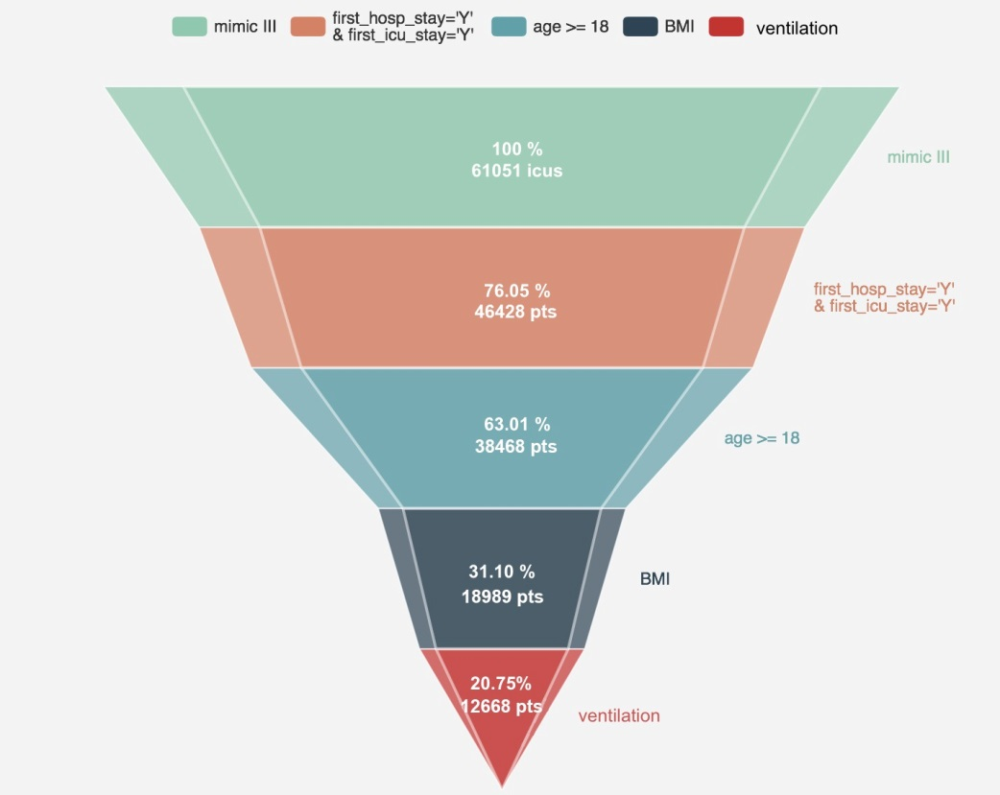
1
患者纳入流程 Flow of Patient Inclusion
Inclusion criterion 纳入标准:
□ ICU critical ill patients need mechanical ventilation.
□ ≥18 years old
Exclusion criterion 排除标准:
□ Cases without BMI data

Slide 15
2
暴露因素 Exposure of interest
Classification
WHO定义
BMI (kg/m²) Classification <18.5 Underweight 18.5-24.9 Normal range 25-29.9 Overweight 30-34.9 Obese class I 35-39.9 Obese class II >40 Obese class III
World Health Organization: WHO Global Database on Body Mass Index. 2006. Available at: http://apps.who.int/bmi/index. jsp? introPage =intro _3.html. Accessed October 12, 2014

Slide 16

3
结局指标 Clinical outcomes
1. Mechanical ventilation time(hours)
2. All cause ICU mortality
3. 30-day, 90-day mortality.
4. The length of stay(LOS) in ICU
5. Tracheotomy rate
6. ICU readmission rate

Slide 17
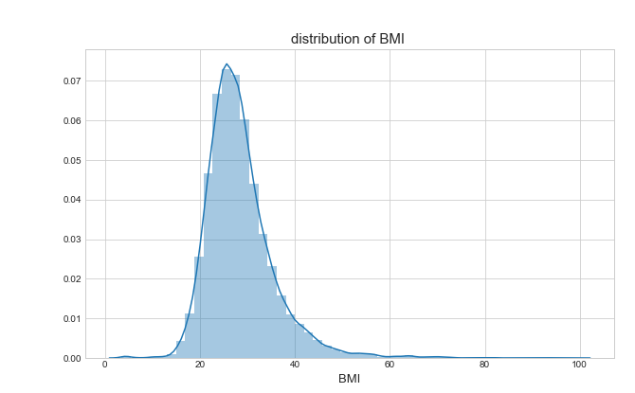
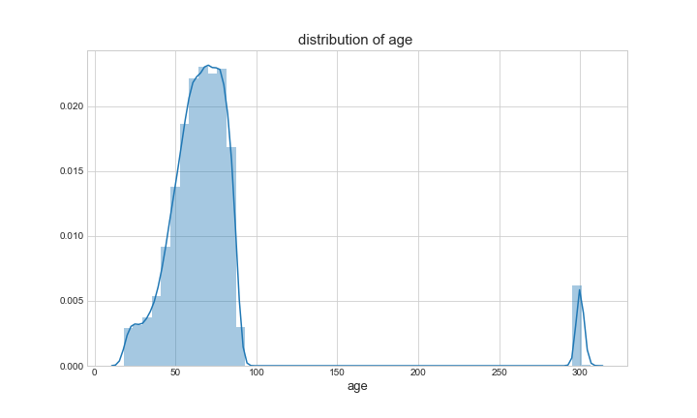
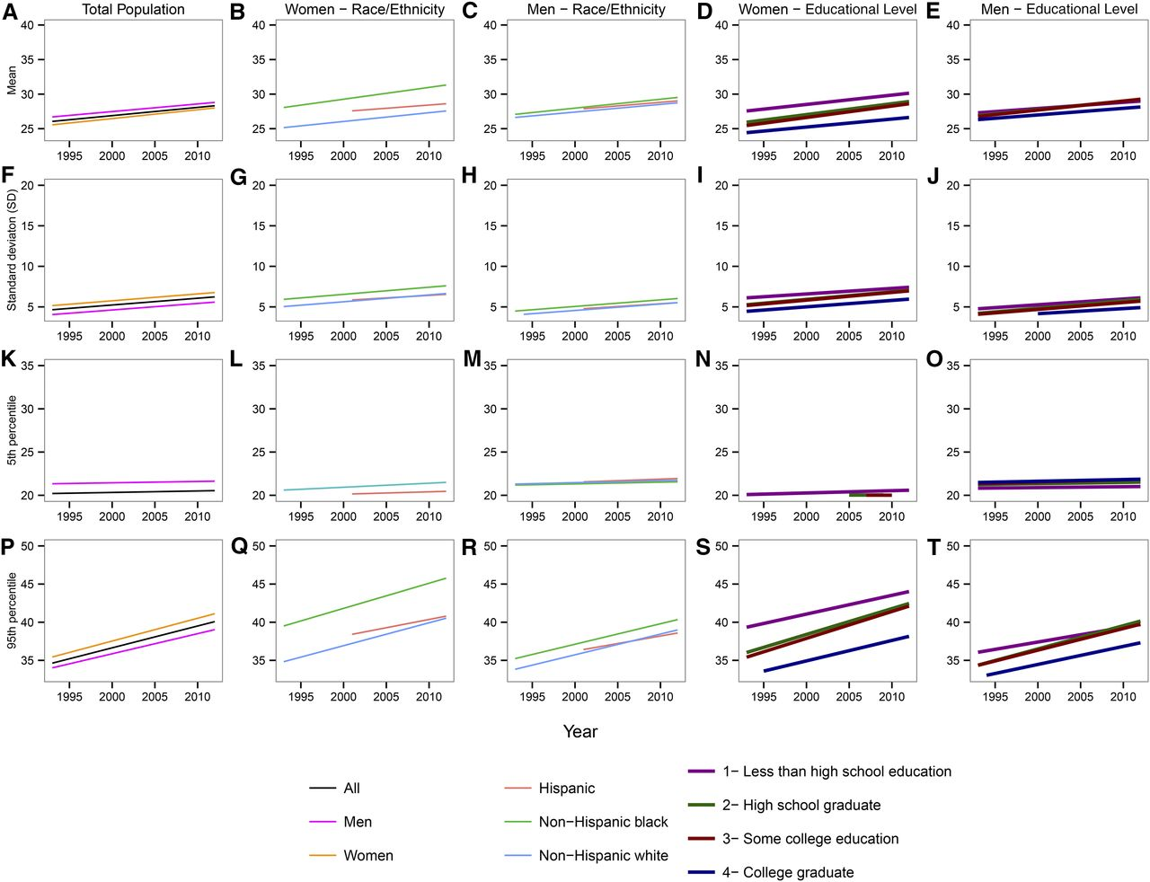
4
探索性分析 exploratory data analysis

Slide 18
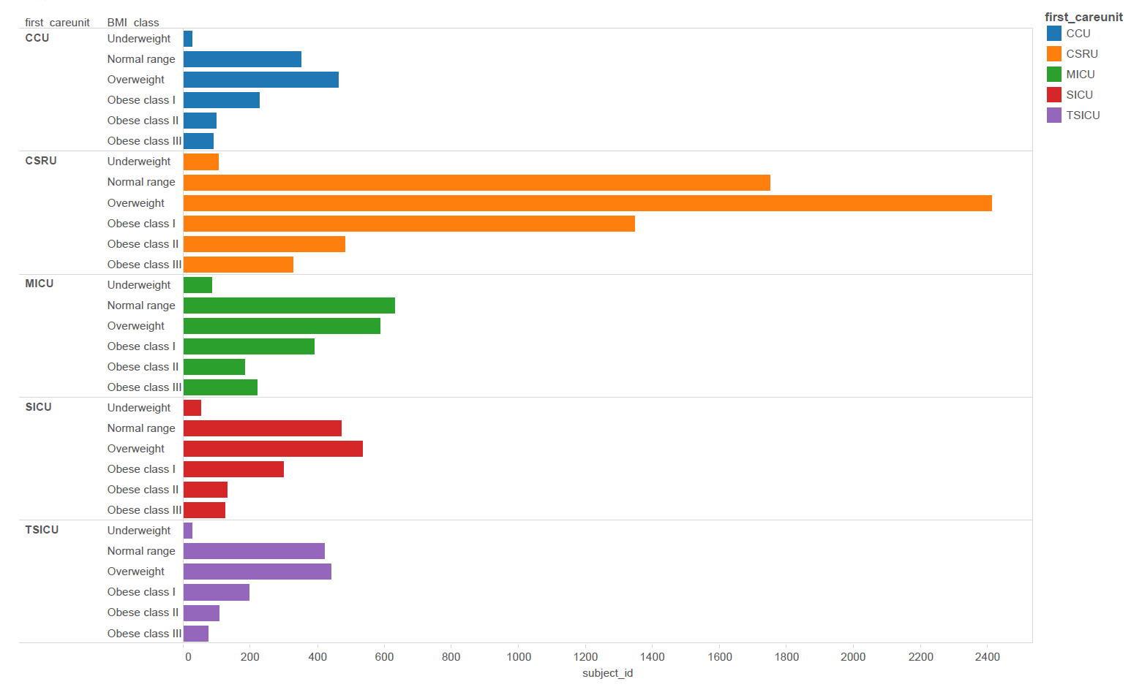
4
探索性分析 exploratory data analysis

Slide 19
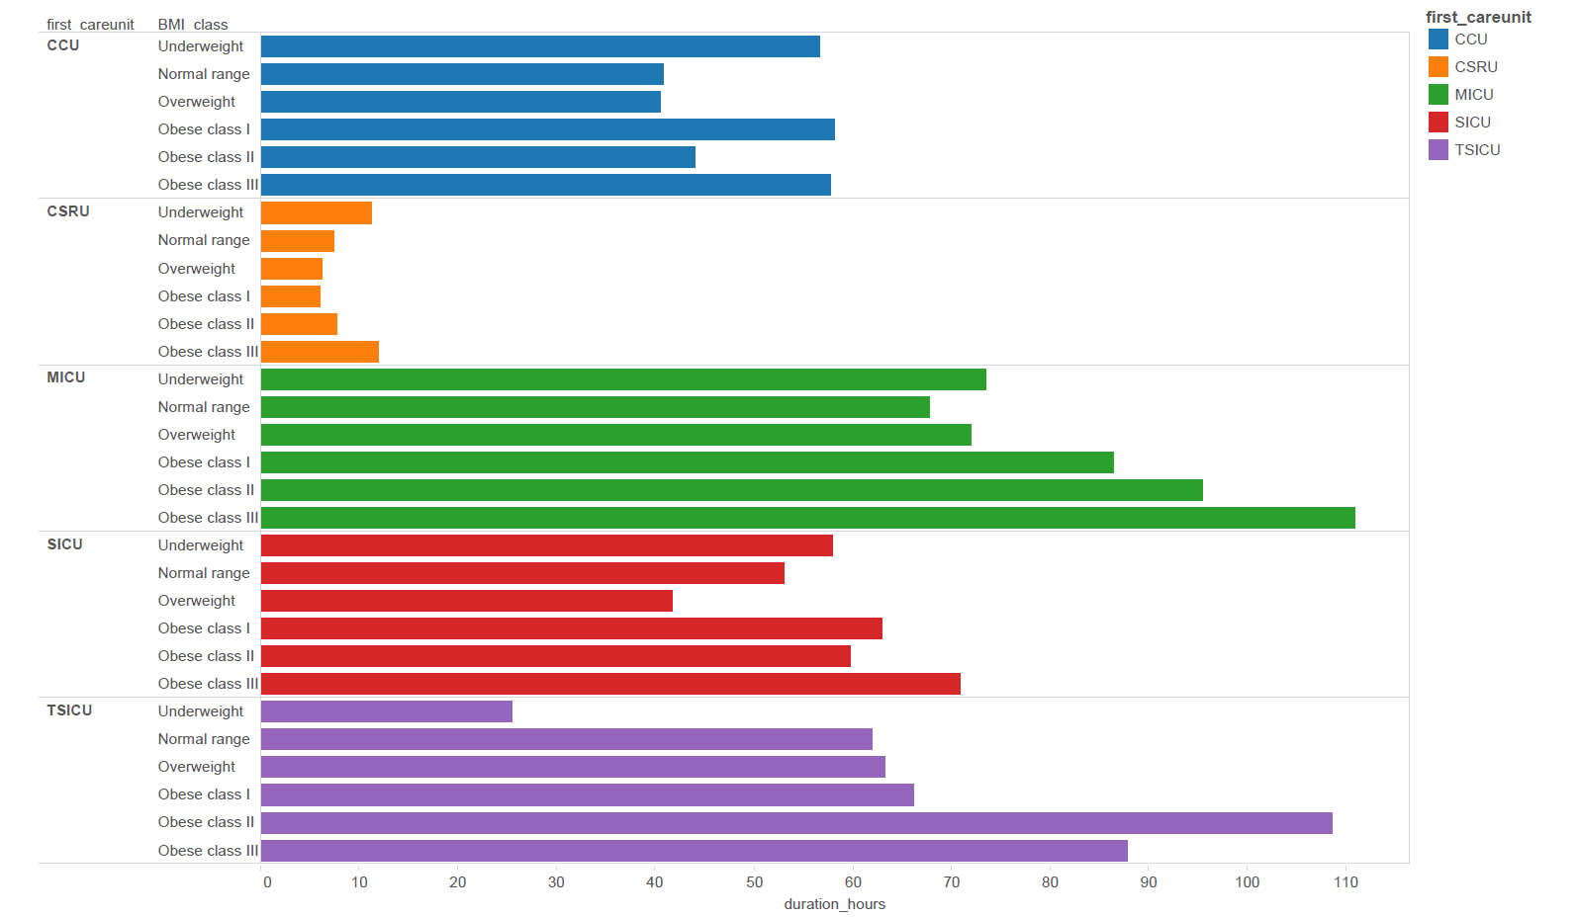
4
探索性分析 exploratory data analysis

Slide 20
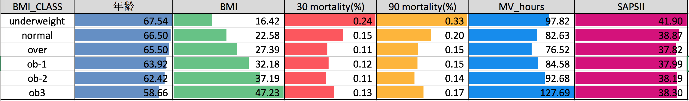
5
Result -Baseline Characteristics of the Entire Cohort
 | underweight | normal | over | ob-I | ob-II | ob-III
age_modi(mean±std.) | 67.54±17.01 | 66.5±17.74 | 65.5±15.57 | 63.92±14.11 | 62.42±13.29 | 58.66±13.35
BMI(mean±std.) | 16.42±2.81 | 22.58±1.69 | 27.39±1.41 | 32.18±1.42 | 37.19±1.4 | 47.23±8.58
SAPSII(mean±std.) | 41.9±14.68 | 38.87±14.41 | 37.82±13.94 | 37.99±14.42 | 38.19±13.8 | 38.3±14.88
MV_duration_hours(mean±std.) | 97.82±154.87 | 82.63±163.07 | 76.52±162.98 | 84.58±166.7 | 92.68±166.65 | 127.69±212.62
los_icu(mean±std.) | 6.83±7.44 | 6.33±8.38 | 5.95±8.2 | 6.33±8.65 | 6.66±8.29 | 8.3±9.85
30 mortality frac | 24.08% | 15.49% | 11.27% | 11.54% | 10.92% | 12.95%
90 mortality frac | 33.44% | 19.98% | 15.05% | 14.91% | 13.9% | 17.27%

Slide 21
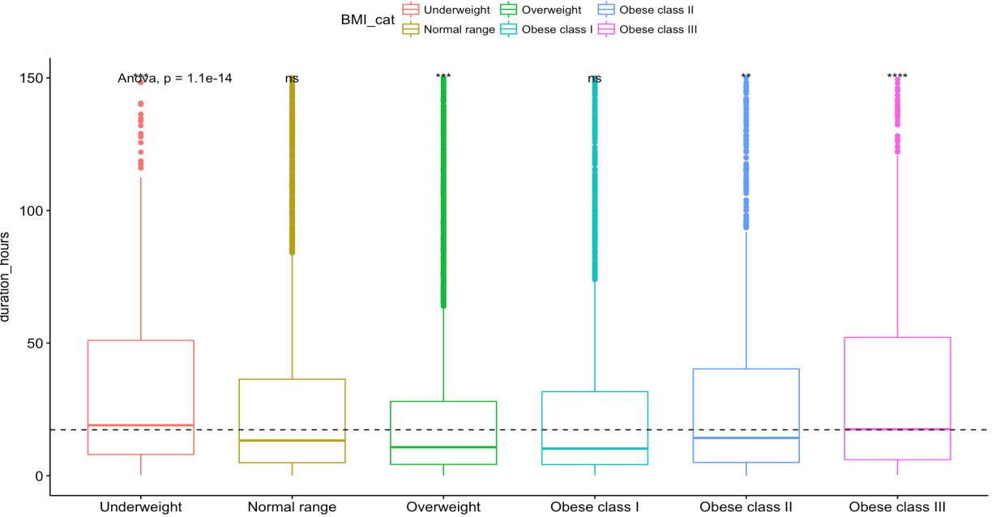
5
结果 Result

Slide 22
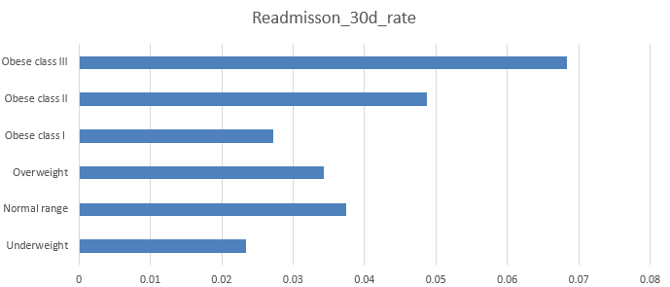
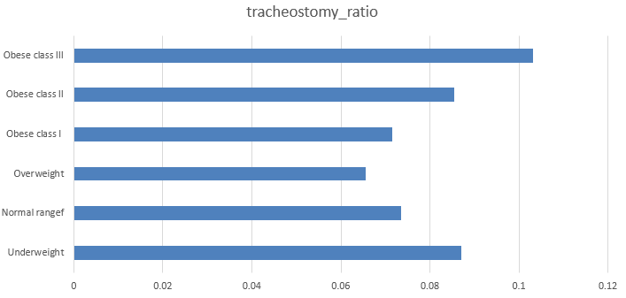

Slide 23
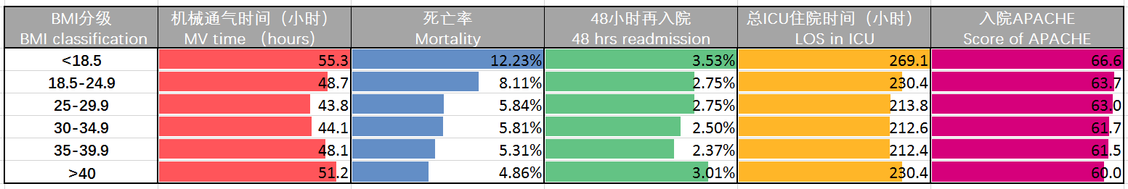
5
eICU数据库情况概览 eICU Database Overview

Slide 24
6
预测通气时间 Forecase MV time(hours)
HotEncoder_Transformation
Standard_Transformation
Deal with NA values
Data Precession
Build Model
Evaluation
RandomForest Regression
Xgboost Regression
MSE
Extracted
_data

Slide 25
6
预测通气时间 Forecase MV time(hours)
Variables | Method
age | Minmax_transformation
gender | Hot_Encoder
BMI | Minmax_transformation
first_careunit | Hot_Encoder
admission_type | Hot_Encoder
saspii | Minmax_transformation
charindex | Minmax_transformation
tracheostomy_flag | keep
… | …

Slide 26
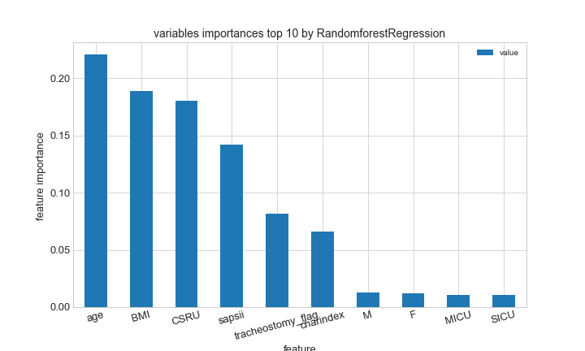
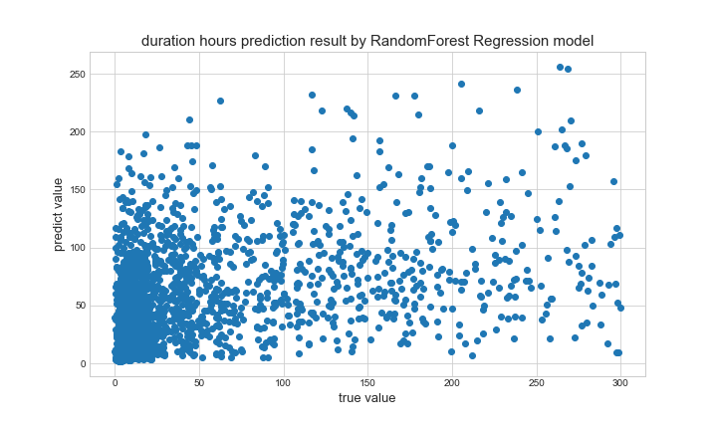
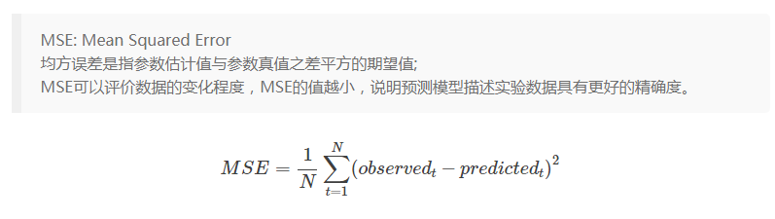
6
预测通气时长结果 Result
MSE:395.95829

Slide 27
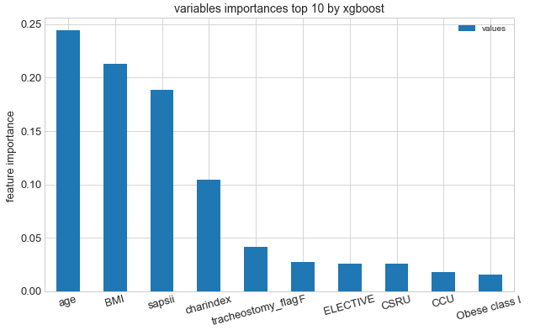
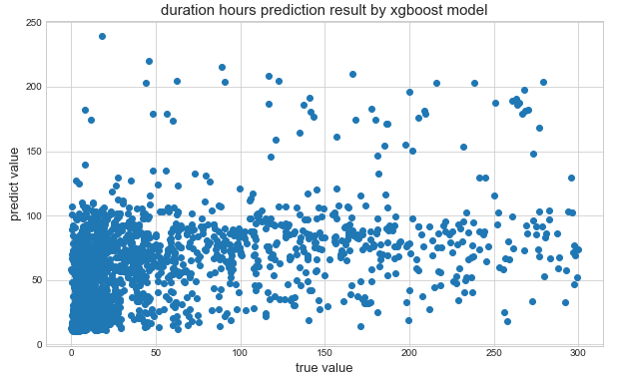
6
结果 Result
MSE:350.14387

Slide 28
7
讨论 Discussion
Some investigations reported that obesity contributed to increase ICU mortality and longer MV time. In our study, it shows a U-shape association with excess mortality in patients who are underweight and in those extreme obesity.
Obesity influences organ function and alter the physiologic response to injury and illness.

Slide 29
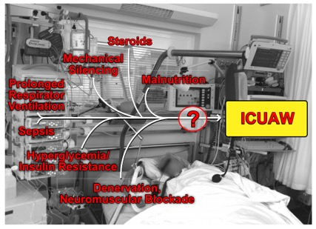
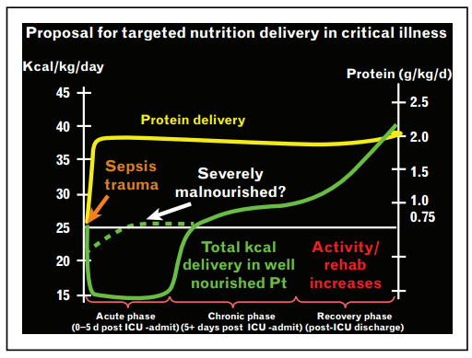
7
讨论 Discussion
Underweight patients trend to be in malnutrition and chronic disease status before admitted to the ICU along with the ICU-AW and hyper metabolism.
Curr Opin Crit Care. 2016.22 (4): 279-84 Physiol Rev. 2015;95(3):1025-109.

Slide 30
7
讨论 Discussion -Limitation
According to clinical practice, obese /underweight patients after surgery or with severe diseases are more likely to be admitted to ICU, so there might be a selective bias. In follow-up work we will do more subgroup analysis and try to adjust these confounders.

Slide 31
7
Preliminary Conclusion
Underweight and extreme obesity
is associated with bad clinical outcomes.

Slide 32

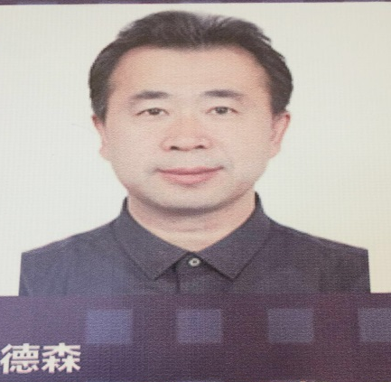


Acknowledgement
I’d like to give my sincere thanks to Prof. Leo Anthony Celi and his team, they give us many helpful suggestion and point out our limitation in the research.
Acknowledge Prof. Cao /Zhang and their team
Thanks all the clinician and data scientist giving us help.

